Slide 1
MDP Value Iteration in Parallel
By Sai Satya Sruthi Reddy and Josh Cunningham

Slide 2
The Markov Decision Process
Markov Decision Process (MDP) is a foundational element of reinforcement learning (RL). MDP allows formalization of sequential decision making where actions from a state not just influences the immediate reward but also the subsequent state.

Slide 3
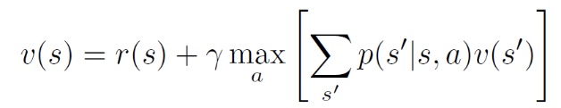
Value Iteration Algorithm
Value iteration is a dynamic programming algorithm for computing an optimal MDP policy and its value.

Slide 4
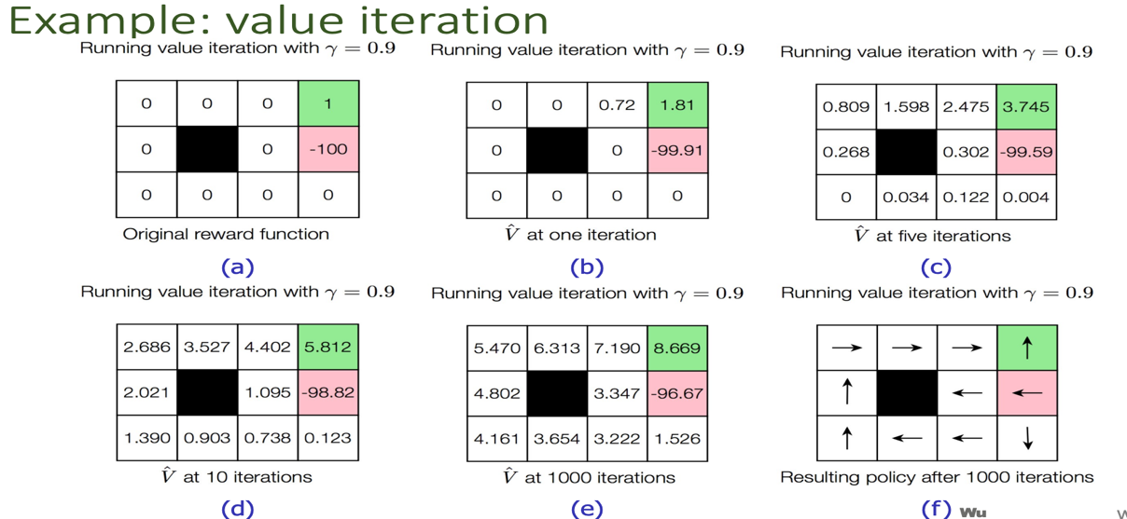
What is Grid World?
Grid world is a simple Markov problem where every state is represented by a square on a grid. The only transitions a state can do are to it’s neighbours. States cannot transition diagonally

Slide 5
Complexity Analysis for Grid World
For a world of NxN, each iteration will have to calculate utility of 4 actions for each of the N² states.
Our goal is the calculate the utility values in parallel which theoretically reduces the time from O(N²) down to O(N).

Slide 6
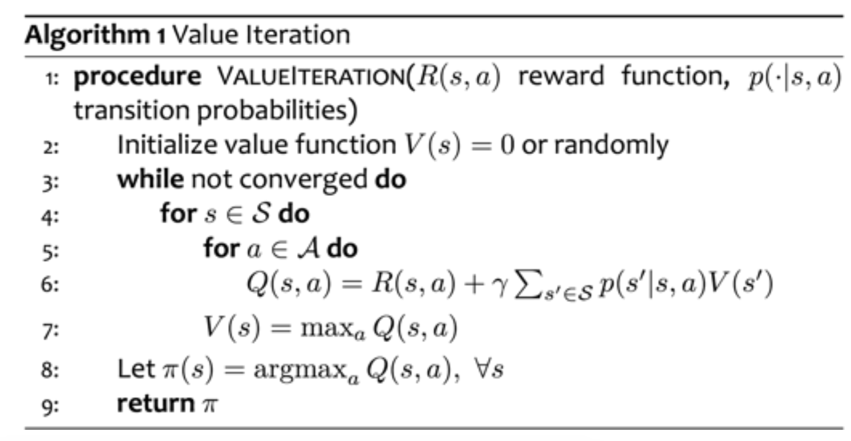
Algorithm

Slide 7
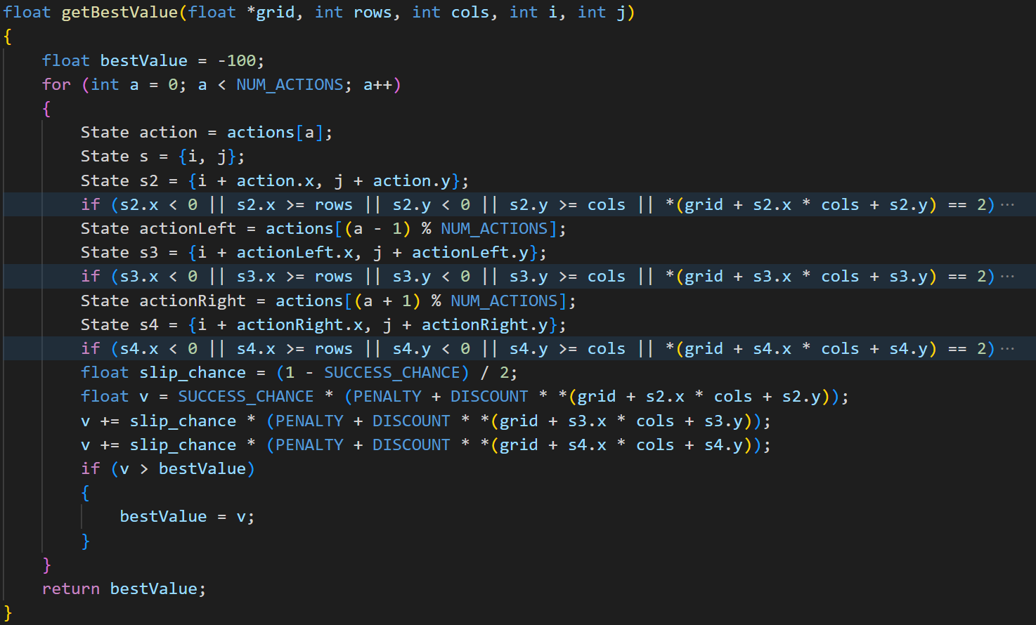

Slide 8
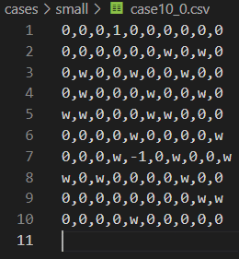
Data Generation
Automatically generated test cases
Square grids sized 10x10 to 500x500
10 random generations per size
Each grid has one win and one loss tile
Each grid has (N/2)² walls in it

Slide 9
Running the Tests
We generated different binaries for serial and parallel implementations
Used a script to run each test case against each binary and collect the runtime and computation time

Slide 10
Results
Size | Computation Time (s) |  |  | RealTime (s)
 | cpu | gpu16 |  | cpu | gpu16
10 | 0.000598 | 0.004077 |  | 0.000703 | 0.0989
20 | 0.003205 | 0.004519 |  | 0.00333 | 0.1013
30 | 0.007735 | 0.004612 |  | 0.007899 | 0.0958
40 | 0.014273 | 0.004532 |  | 0.014494 | 0.0976
50 | 0.022784 | 0.004620 |  | 0.023083 | 0.0971
60 | 0.032893 | 0.004696 |  | 0.033287 | 0.0974
70 | 0.045284 | 0.004664 |  | 0.045785 | 0.0959
80 | 0.058211 | 0.004627 |  | 0.058841 | 0.1003
90 | 0.074054 | 0.005147 |  | 0.074824 | 0.0973
100 | 0.089967 | 0.004619 |  | 0.090894 | 0.0976
200 | 0.351189 | 0.005923 |  | 0.354604 | 0.1013
300 | 0.780894 | 0.007223 |  | 0.788519 | 0.1079
400 | 1.393062 | 0.00967 |  | 1.406467 | 0.113
500 | 2.166679 | 0.013789 |  | 2.187773 | 0.1259

Slide 11
Computation time

Slide 12
Runtime

Slide 13
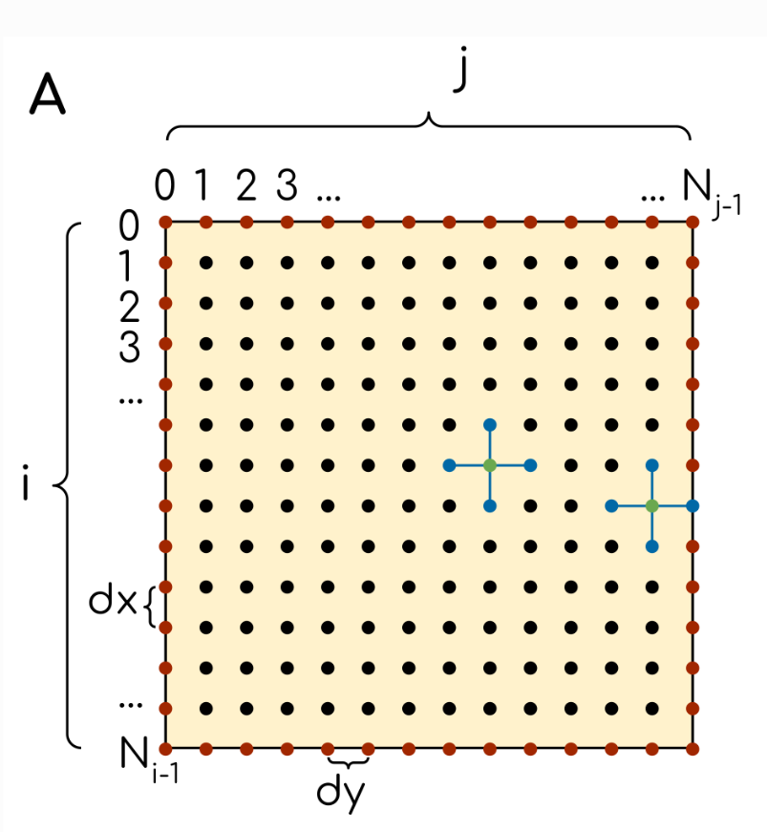
Similar problems
Solving a heat distribution in parallel is quite similar
Same grid layout
Each cell’s value is determined by it’s neighbours

Slide 14
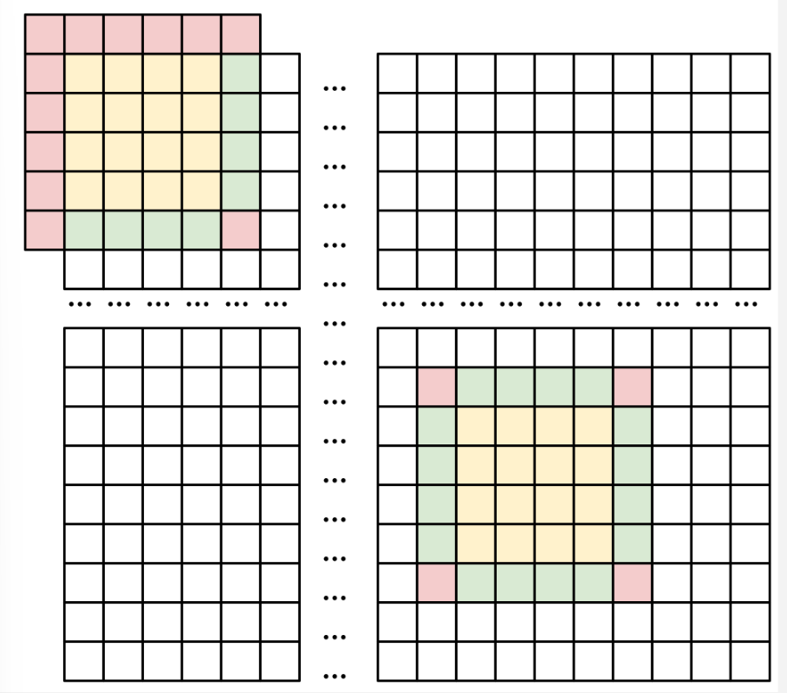
Further Work/Optimizations
Use shared memory
Remove the check flag
Guess iterations to convergence
Further reduce memory copying
Value calculation warp divergence
Surrounding buffer

Slide 15
Conclusion
1573% speedup on 500x500 grid
Overhead makes gpu slower until 100x100
Relaxing the constraints might be needed for maximum efficiency
Grid world is very well suited for GPU speedup because it closely resembles the structure of an image

